Slide 1

MealMate
Connecting Donners With Needy People
Submitted To
Name: Abida Sultana Lecturer of CSE
Green University Of Bangladesh

Slide 2
Meet Our Team
Name: Md. Abu Sufian
ID: 221002136
Name: Md Arif Billah
ID: 221002520

Slide 3
Presentation Agenda
01
02
03
Problem Statement
Solution – MealMate
Key Features
05
06
Live Demonstration
Conclusion & Learnings
See the AI in action!
Key takeaways and future thoughts.

Slide 4

Problem Statement
Every day, large amounts of food are wasted.
At the same time, many people struggle with hunger.
Lack of an easy system to connect donors with those in need.

Slide 5
Solution – MealMate
A mobile app that bridges the gap.
Donors can share surplus food.
Needy people or NGOs can collect food.
Ensures safe, quick, and transparent food sharing.

Slide 6
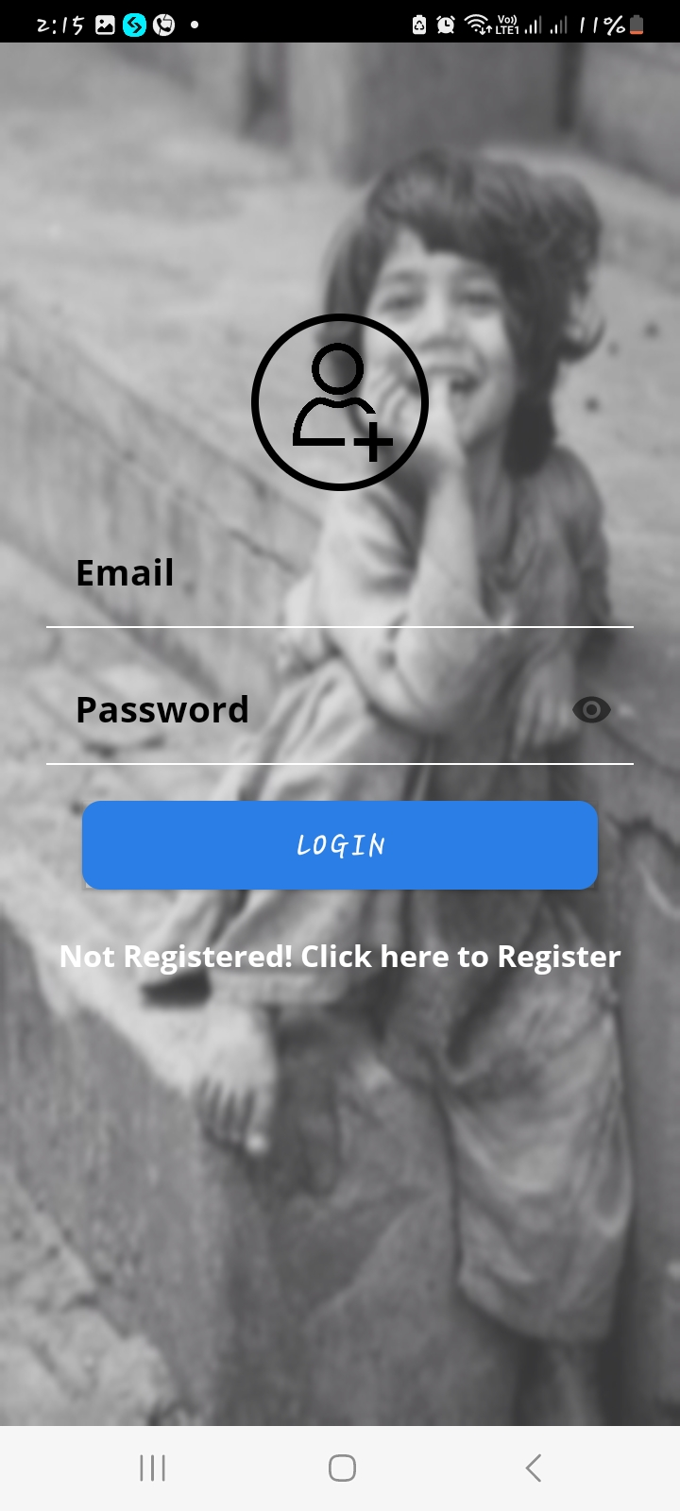
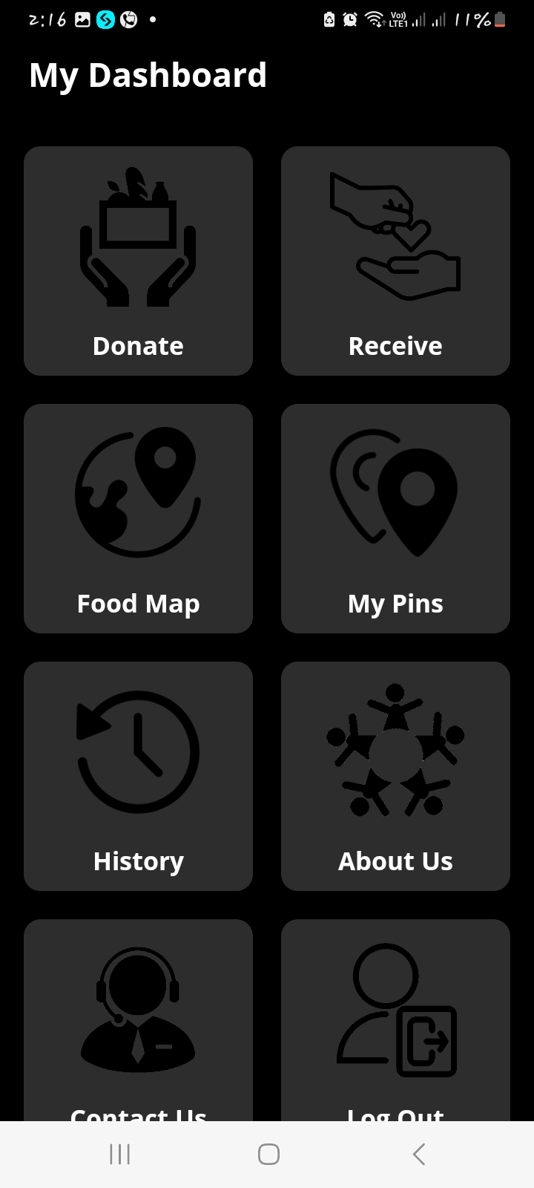
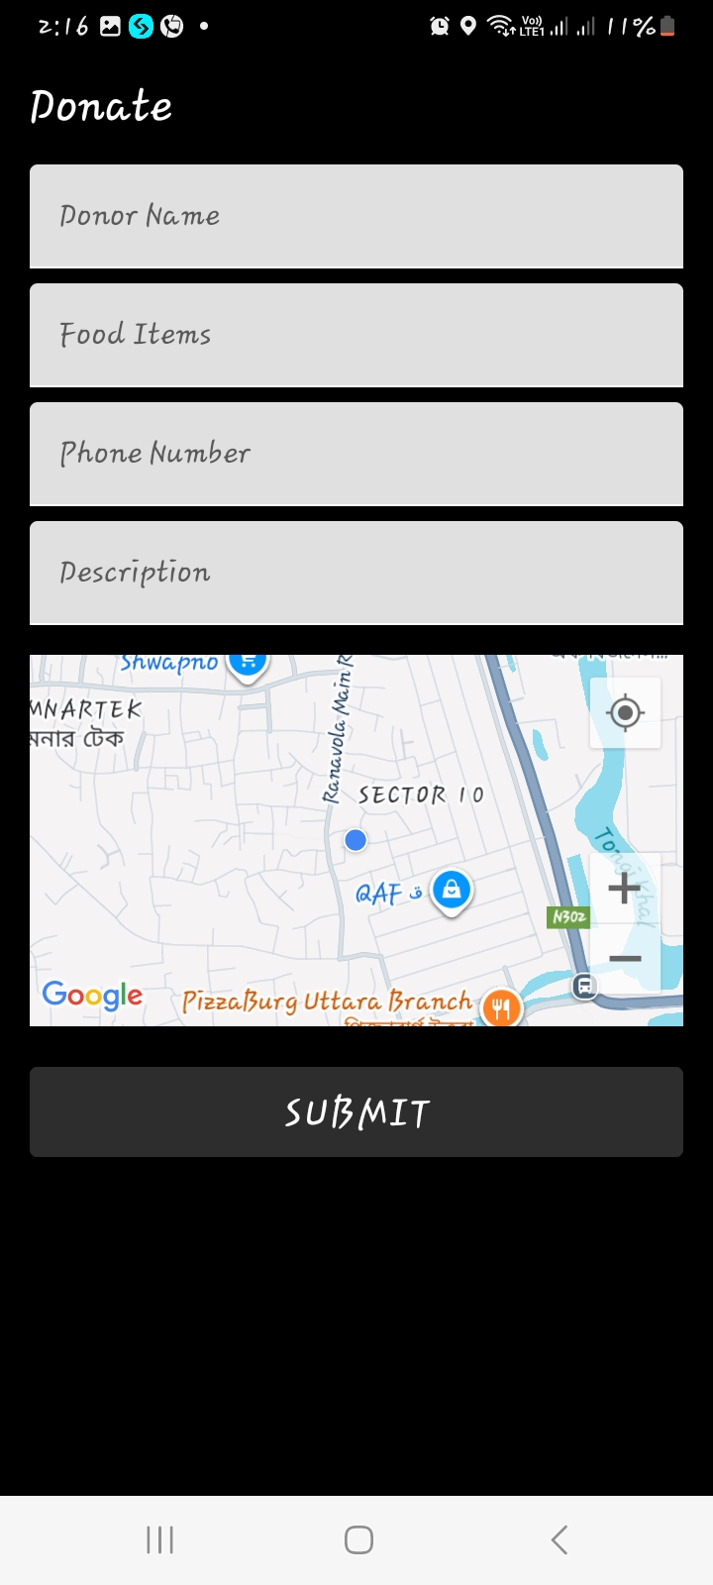
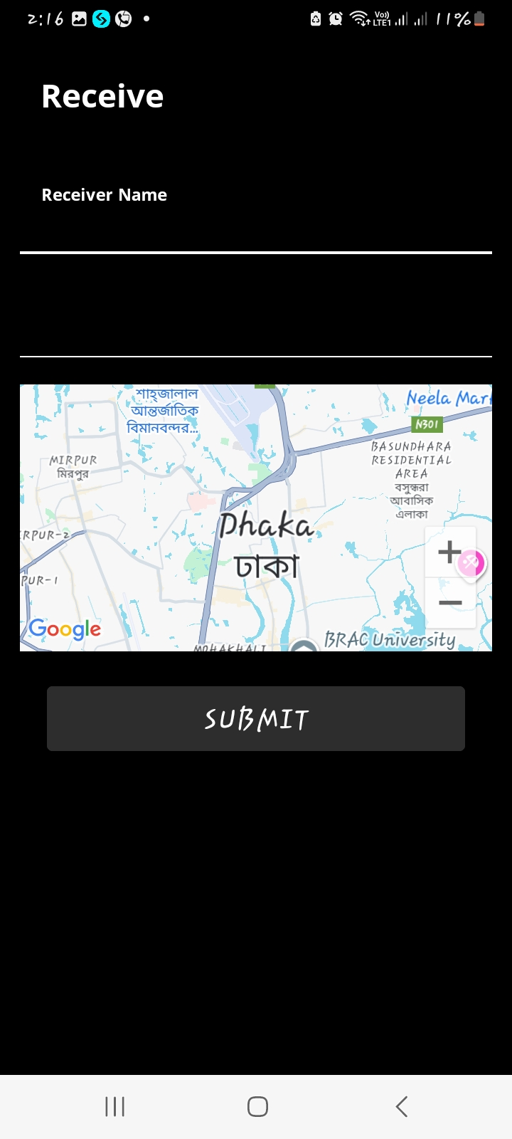
Key Features
User Signup/Login
Request & Accept Donations
Request & Receive Donations
Add & Manage Food Donations

Slide 7

Conclusion
The conclusion emphasizes the main purpose of MealMate: reducing food waste and fighting hunger by connecting donors with people in need.
The tagline
"Share a meal, spread a smile." — highlights the social impact and emotional value of the app.

